Slide 1

Exploratory Data Analysis (EDA) for Real Estate Pricing:
Unveiling the Dynamics of House Valuation in a Dynamic Market

Slide 2

Introduction
By leveraging advanced data analytics techniques and visualization tools, goal is to uncover patterns, correlations, and trends within the dataset, enabling the company to make informed decisions and strategically position properties for better business opportunities.

Slide 3
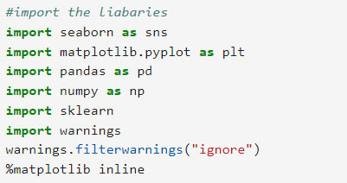
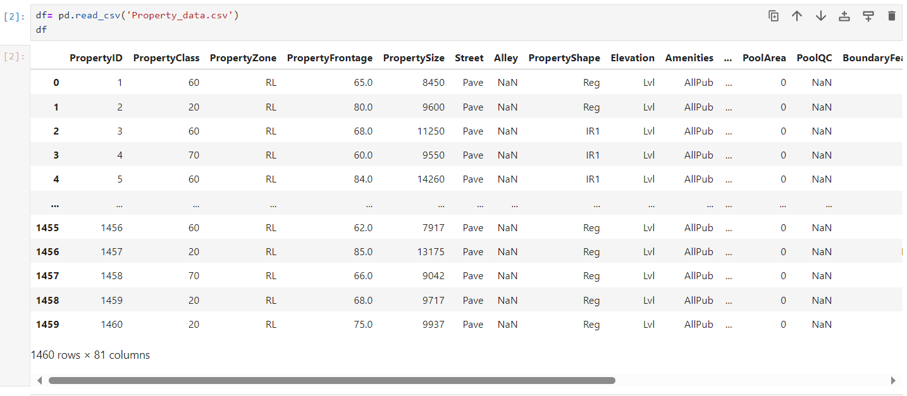
Import necessary packages I used
Loading the Data:

Slide 4
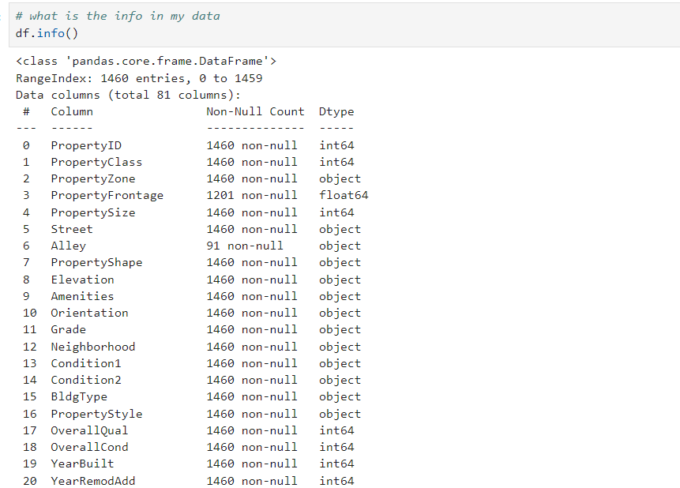
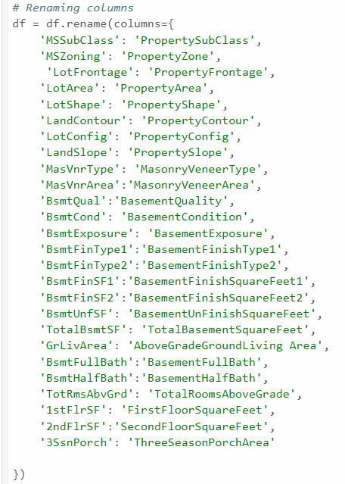
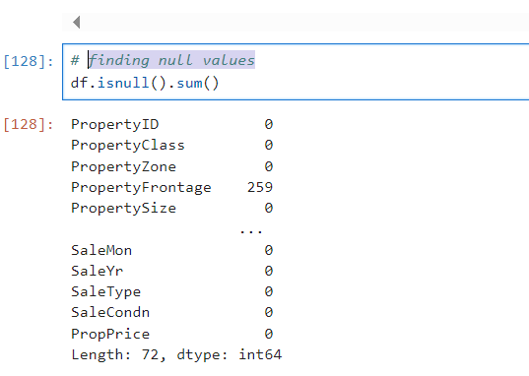
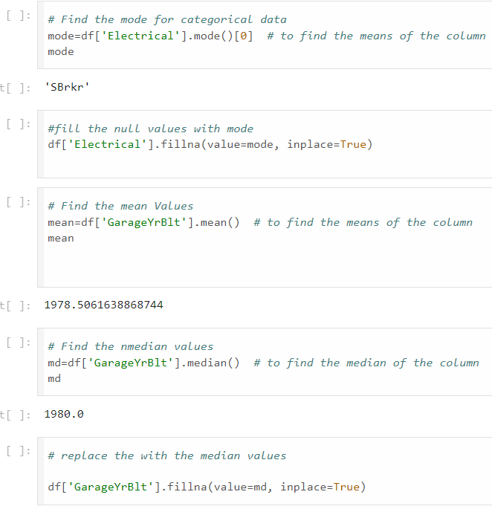
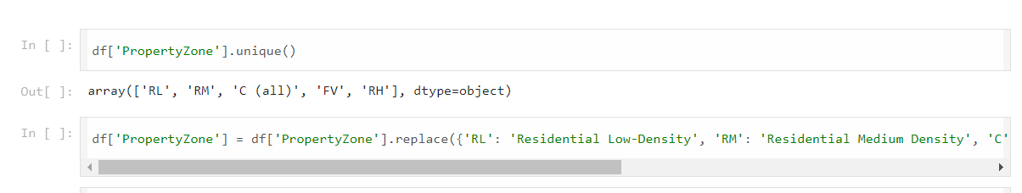
Cleaning the Data:
4. Find null values and fill the data
2. Renaming the Columns names for better understanding
1. Find the Info of my data
3. Find unique values and replace the names of data

Slide 5
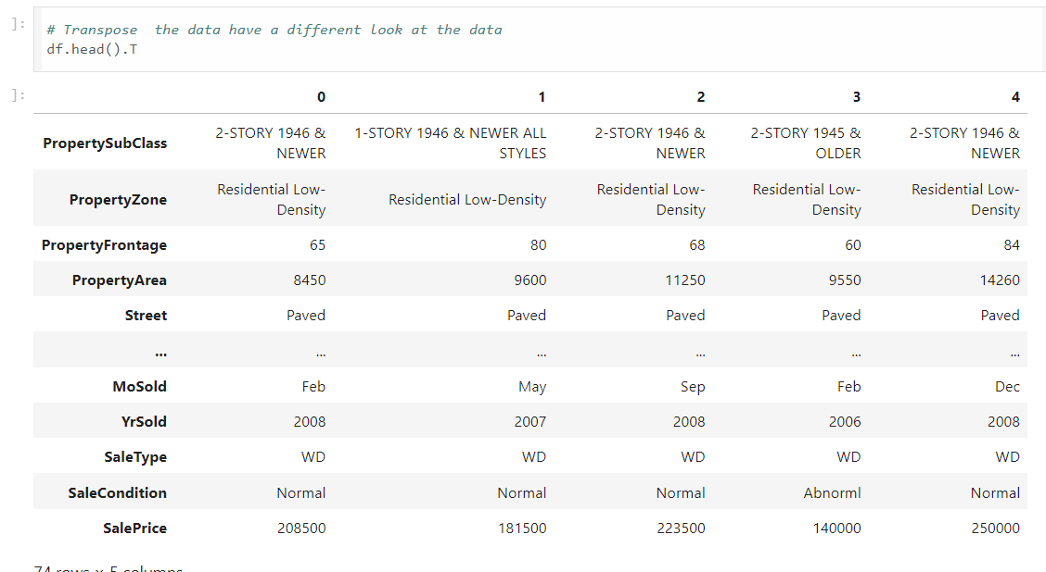
Transpose the data have a different look at the data

Slide 6
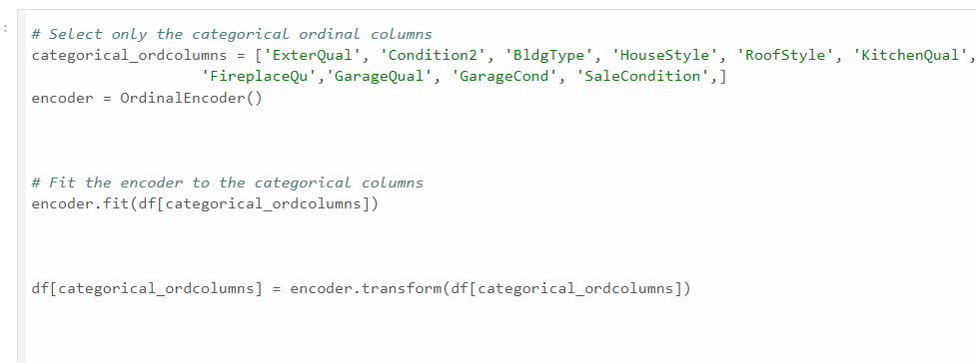
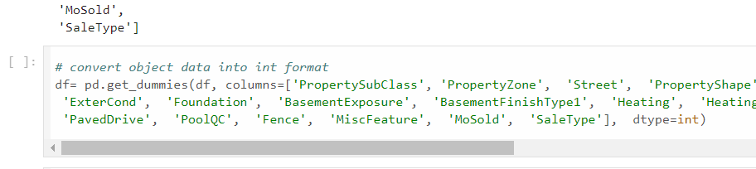
Convert Categorical data into int.
Identify numerical and categorical data
num_columns = df.select_dtypes(include=['number']).columns.to_list()
cat_columns = df.select_dtypes(include=['object']).columns.to_list()
For categorical ordinal columns
For nominal catgorical columns

Slide 7
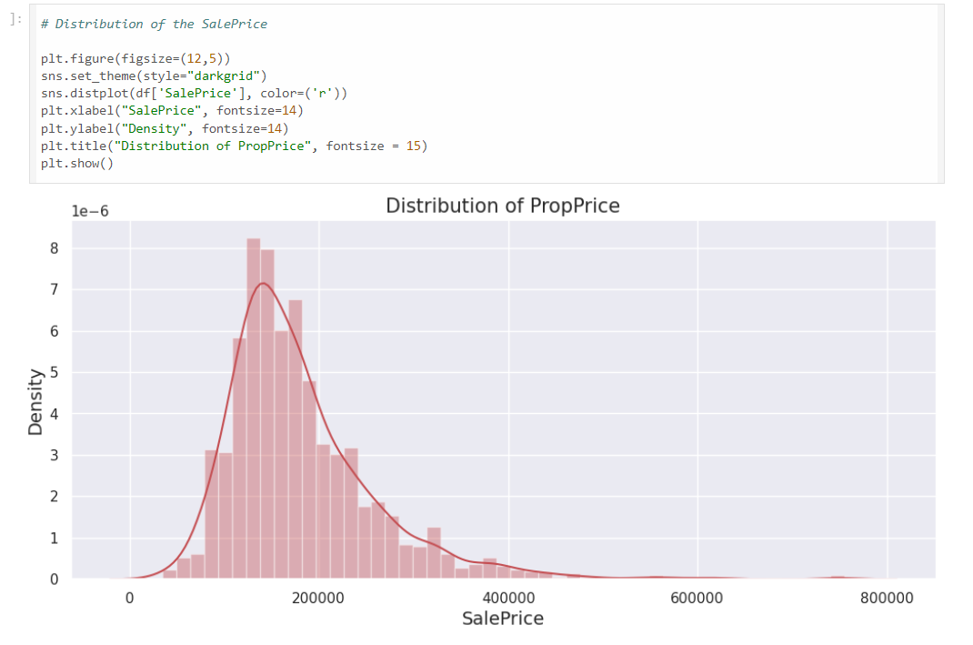
Perform of EDA
Feature Engineering and Size Impact:
Market Trends and Historical Pricing:
Customer Preferences and Amenities:
Univariant analysis of the maket price with distplot that show distribution of price over the period

Slide 8
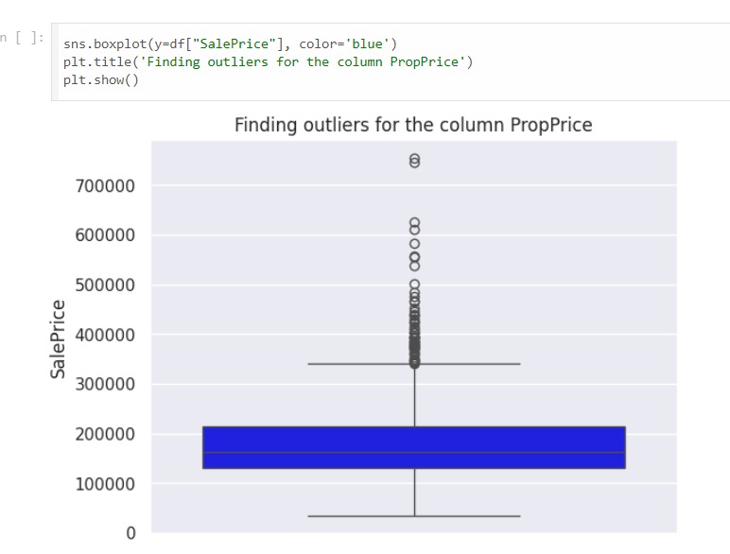
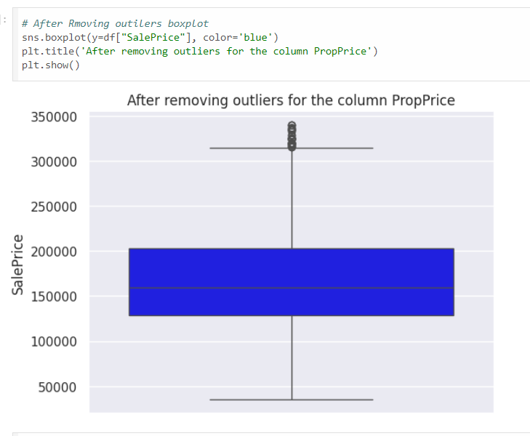
Box plotting for outilers
After removing the outliers

Slide 9
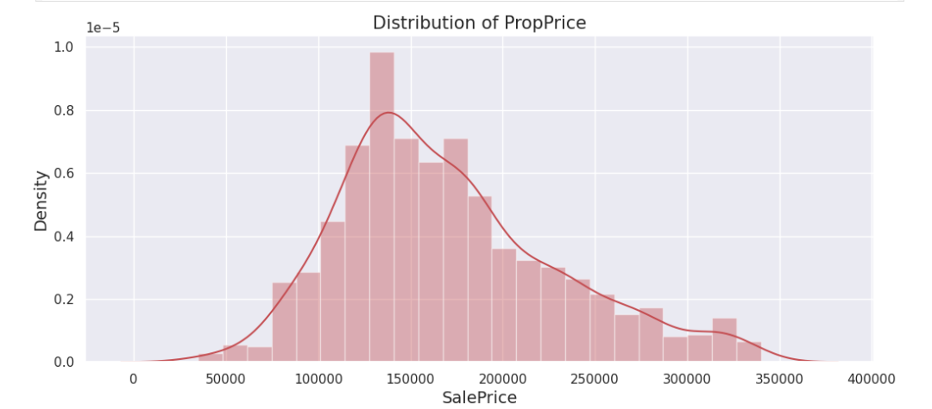
Check the difference in the distribution of property price after removing the outliers
Before removing the outliers
After removing the outliers

Slide 10
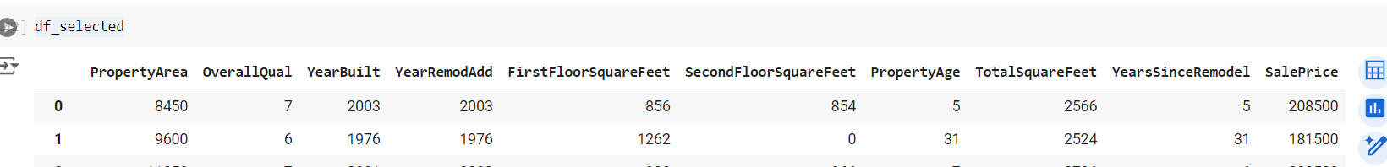
Add new features in data frame
PropertyAge
TotalSquareFeet
YearsSinceRemodel
# Creating new features
df['PropertyAge'] = df['YrSold'] - df['YearBuilt']
df['TotalSquareFeet'] = df['FirstFloorSquareFeet'] + df['SecondFloorSquareFeet'] + df['TotalBasementSquareFeet']
df['YearsSinceRemodel'] = df['YrSold'] - df['YearRemodAdd']

Slide 11
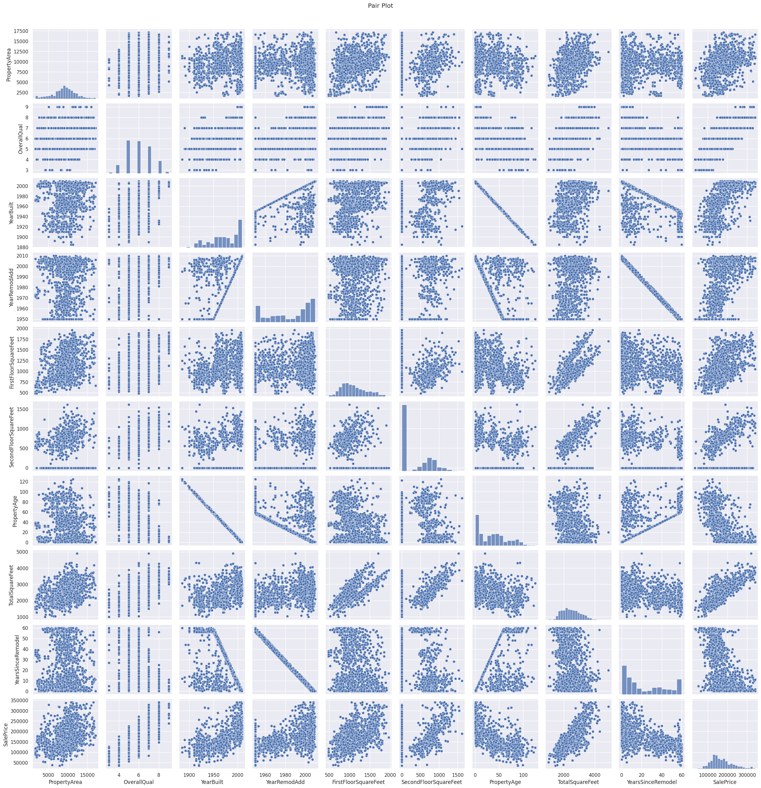
Multivariate Analysis: Pair Plot

Slide 12
Multivariate Analysis:
The pair plot visualizes the relationships between Key pairs of variables
OverallQual and PropPrice: High correlation, indicating quality significantly affects property price.
TotalSquareFeet and PropPrice: Strong positive correlation, larger properties tend to be more expensive
FirstFloorSquareFeet and TotalSquareFeet: High correlation, indicating first floor size is a significant component of total size.
YearBuilt and Age: Strong negative correlation, as expected (older properties have higher 'Age')
OverallQual and TotalSquareFeet likely have significant positive coefficients, reinforcing their importance in determining property prices.
YearBuilt and YearsSinceRemodel might have varying impacts, potentially showing significant influence or multicollinearity issues.
Property quality and total size are the strongest predictors of price.

Slide 13

Thank You

